Slide 1
ANN Continue……..
Mohammed Mansoor.O.
EEE
TKMCE KOLLAM

Slide 2
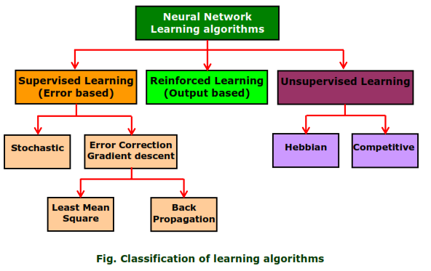
Learning Methods

Slide 3
Unsupervised Learning
No teacher is present.
The expected or desired output is not presented to the network.
The system learns of it own by discovering and adapting to the structural features in the input patterns.

Slide 4
Reinforced learning
A teacher is present but does not present the expected or desired output
But only indicated if the computed output is correct or incorrect.
The information provided helps the network in its learning process.
A reward is given for correct answer computed and a penalty for a wrong answer
THIS IS NOT A POPULAR LEARNING METHOD

Slide 5
Unsupervised learning
Competitive learning
Hebbian learning

Slide 6
Competitive Learning
Several neurons are there in output layer
For a stimulus output neurons compete with each other to create out put closer to target
Neurons which responds strongly(winning neuron) to an input stimulus, its weight get updated
Thus for an input pattern one neuron become dominant one in out put signal and other output neuron become dominant for other stimulus and so on.
This strategy is called "winner-takes-all".

Slide 7
Hebbian Learning
Proposed by Donald Hebb, based on corrective weight adjustment
If 2 neurons on either side of a synapse are activated simultaneously( Synchronously ) then the strength of that synapse selectively increases
If 2 neurons on either side of a synapse are activated asynchronously then the strength of that synapse selectively weakened or eliminated
Such a synapse is called Hebbian synapse
A
B
Axon
Repeatedly fires

Slide 8

“A synapse that uses time dependent and strongly interactive mechanism to increase synaptic efficiency as a function of correlation between pre synaptic and post synaptic activities”
The synaptic weight between A & B is modified according to the correlated activity between output and input
the input-output pattern pairs (Xi , Yi) are associated by the weight matrix W, known as correlation matrix computed as

Slide 9
Gradient descent Learning
This is based on the minimization of errors E defined in terms of weights and the activation function of the network.
Here, the activation function of the network is required to be differentiable, because the updates of weight is dependent on the gradient of the error E.
If ∆W_{ij} is the weight update of the link connecting the i th and the j th neuron of the two neighboring layers, then ∆Wij is defined as
∆W_{ij} = η(∂E/∂Wij )
where η is the learning rate parameters and (∂E/∂W_{ij}) is error gradient with reference to the weight W_{ij} .
Eg. Back propagation learning algorithm

Slide 10
Stochastic Learning
In this method the weights are adjusted in a probabilistic fashion.
Example : Simulated annealing which is a learning mechanism
Employed by Boltzmann and Cauchy machines.

Slide 11

Single layer Perceptron
The Perceptron is a computational model of retina of eye. Basically it is a pattern recognition system.
An arrangement of one input layer of neurons feed forward to one output layer of neurons is known as Single Layer Perceptron.

Slide 12
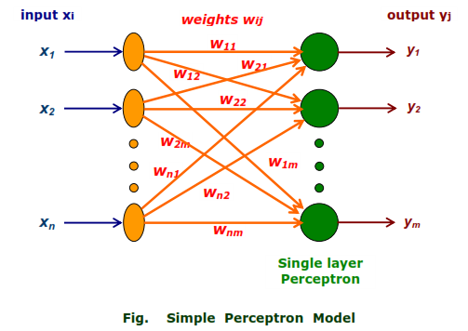

Slide 13


Learning Algorithm : Training Perceptron
The training of Perceptron is a supervised learning algorithm where weights are adjusted to minimize error when ever the output does not match the desired output.
If the output is correct then no adjustment of weights is done.
If the output is 1 but should have been 0 then the weights are decreased on the active input link

Slide 14

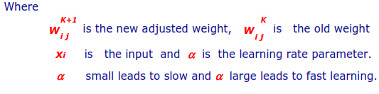
If the output is 0 but should have been 1 then the weights are increased on the active input link

Slide 15
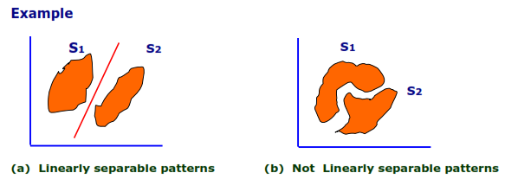
Perceptron and Linearly Separable Task
Perceptron can not handle tasks which are not separable.
Sets of points in 2-D space are linearly separable if the sets can be separated by a straight line.

Slide 16
Generalizing, a set of points in n-dimensional space are linearly separable if there is a hyper plane of (n-1) dimensions separates the sets.
Perceptron cannot find weights for classification problems that are not linearly separable.

Slide 17

XOR Problem
XOR is logical Exclusive OR operation described by the truth table
Even parity is, even number of 1 bits in the input and Odd parity is, odd number of 1 bits in the input
The problem for ANN is to classify the input as odd parity or even parity.

Slide 18
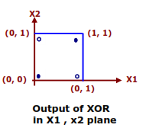
This is impossible, since as is evident from the figure that Perceptron is unable to find a line separating even parity input patterns from odd parity input patterns.

Slide 19
OBJECTIVE
X0=1
W0
Net=W₀+W₁X₁+W₂X₂
X1
W1
Class C1
X2
W2
Class C2
Fig. A Perceptron model with two input X1 and X2
Here Net=W₀+W₁X₁+W₂X₂ represents the equation of straight line. The straight line act as a decision boundary separating the points in to two classes C1 and C2 above and below the line respectively .This is what a Perceptron aim by adjusting its weight .

Slide 20
Perceptron Learning Algorithm
AIM:- To adjust the weights so that perceptron produce a line that separate the space into two halves
Ie. Class 1: Class giving output 1
Class 2: Class giving output 2
(Fixed Increment Learning Algorithm)

Slide 21

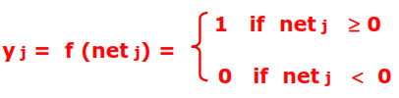
STEP1:- Create a Perceptron with (n+1) input neurons x₀ , x₁ , . . . . . , . x_{n} , where x₀ = 1 is the bias input. Let O be the output neuron.
STEP2:Initialize weight W = (w₀ , w₁ , . . . . . , . w_{n} ) to random weights.
STEP3:- Iterate through the input patterns Xj of the training set using the weight set; ie compute the weighted sum of inputs for each input pattern j
STEP 4:- Compute the output y j using the step function
Where

Slide 22
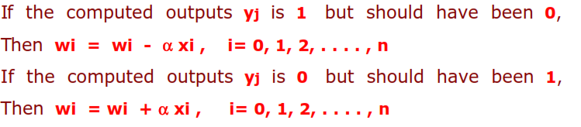
STEP 5:- Compare the computed output y_{j} with the target output Y_{j} for each input pattern j . If all the input patterns have been classified correctly, then output(read) the weights and exit.
Step 6 : Otherwise, update the weights as given below :
Step 7 : Go to step 3 and repeat
END

Slide 23
Applications of Neural Network
Neural Network Applications can be grouped in following categories:
■ Clustering:
A clustering algorithm explores the similarity between patterns and places similar patterns in a cluster. Best known applications include data compression and data mining.
■ Classification/Pattern recognition: The task of pattern recognition is to assign an input pattern (like handwritten symbol) to one of many classes. This category includes algorithmic implementations such as associative memory.
■ Function approximation : The tasks of function approximation is to find an estimate of the unknown function subject to noise. Various engineering and scientific disciplines require function approximation.
■ Prediction Systems: The task is to forecast some future values of a time-sequenced data. Prediction has a significant impact on decision support systems. Prediction differs from function approximation by considering time factor. System may be dynamic and may produce different results for the same input data based on system state (time).

Slide 24
Back Propagation Algorithm- 1986
A systematic method of learning method of multilayer feed forward ANN.(may have more than one hidden layer)
It has high mathematical foundation and very good application potential.
Based on this algorithm, network learns a distributed associative map between input and output layers. If there are more hidden layer, the more difficult is to calculate the weight of the hidden layers.

Slide 25
Prerequisite
The prerequisite to start B.P learning process are
A Set of learning pattern(data),input & target.
A value for learning rate(α)
A criterion that terminate learning algorithm.
A methodology for updating weights
A non-linearity function (Usually sigmoid)
Initial weight (small random values)
Al these depends on requirement and application for it is used.

Slide 26
STEPS INVOLVED
Step 1:- Apply first input pattern X_{k} and target O/P T_{k.}
Step 2:- Input propagate through all layers of neurons and we get final output.
Step 3:- Final output response is compared with target out put and an error signal is produced.
Step 4:- Algorithm calculate rate of change of error. i.e. the rate at which the error changes as the activity level of neuron changes .

Slide 27
Step 5:- Algorithm steps back one layer and recalculate the weight of output layer so that output error is minimized.(Wt b/n Last hidden layer and output layer)
Step 6:- Algorithm next calculate the error output at the hidden layer and compute new value for weights between last and next to last hidden layer.
Step 7:- It goes on repeating this procedure until input layer is reached.
Step 8:- Algorithm select new input target pattern and repeat the process.
Here response move in one direction and weights are updated by moving backwards and hence this method is known as back propagation algorithm.

Slide 28
MATHEMATICAL ANALYSIS
#1:- Normalize the input and output with respect to their maximum values.
Let there be ‘l’ inputs---------{I}_{lx1}
Let there be ‘n’ output-------{O}_{nx1}
Let there be ‘m’ neurons in the hidden layer.
Let [V] be the weight between hidden layer and input layer.
Let [W] be the weight between hidden layer and output layer.
Weights are normally initialised by a small random value between +1 and -1

Slide 29
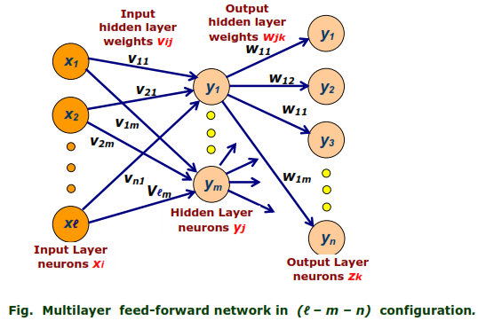

Slide 30

#2:- From training data, present one set of input and output, usually the first layer is used to fan out the input(distribute),thus for first layer
Input=out put
i.e.
#3:- Input to the hidden layer is
#4:- Out put of hidden layer is evaluated using say sigmoid function with α=1

Slide 31


#5:- Now at the out put layer, the input of output layer is
#6:- Output of output layer is
#7:- Error is calculated for any training data as
Error squre is taken to consider absolute value

Slide 32




#8:- To reduce final learning error,
and it can be calculated as
#9:- Modify weight W as W^{t+1}=W^{t}+∆W . i.e.
#10:- Modify the weight to hidden layer
#11:-
#12:- Repeat the steps till convergence is reached

Slide 33
BEST WISHES FOR YOUR FUTURE LIFE
THNK YOU……..

